Slide 1
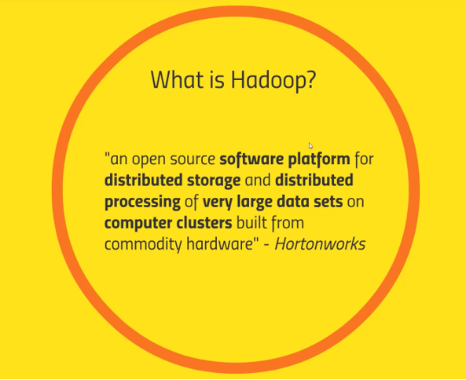

Slide 2
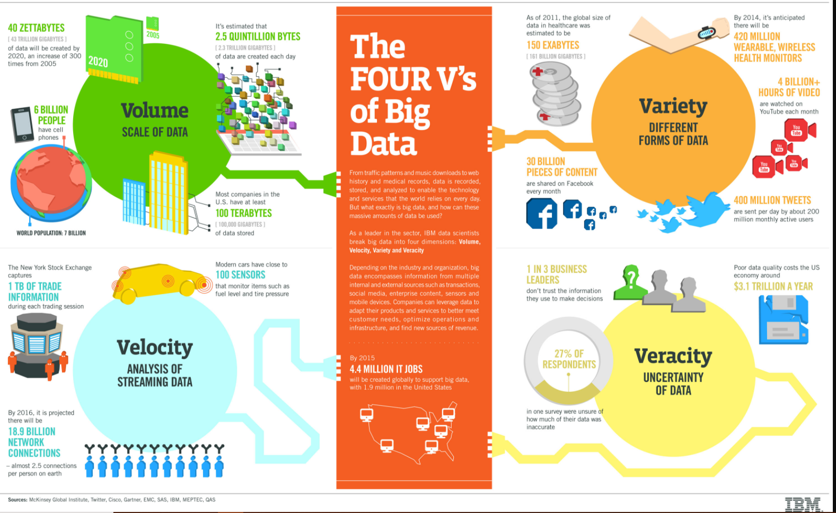

Slide 3
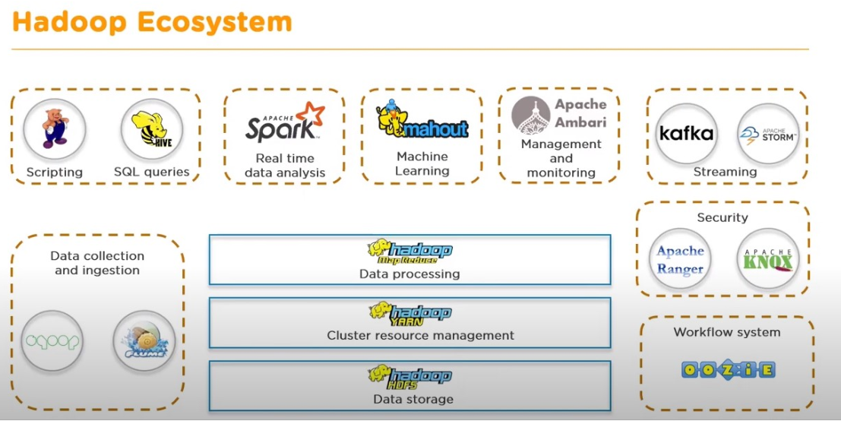

Slide 4
Hadoop Components
Notes:
1.Storage
2.Processing
3.Resource Management

Slide 5
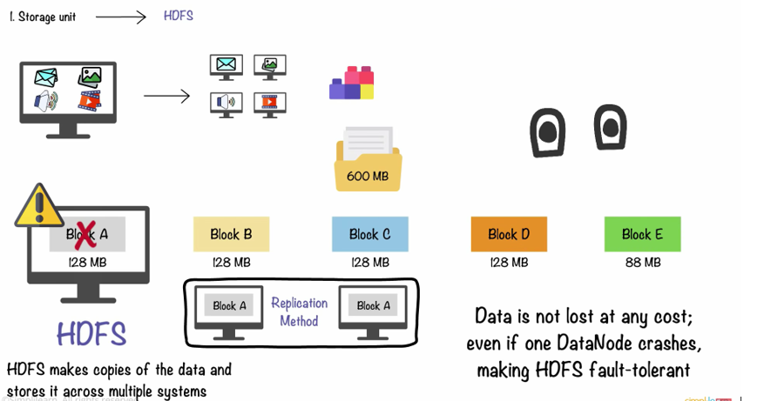

Slide 6
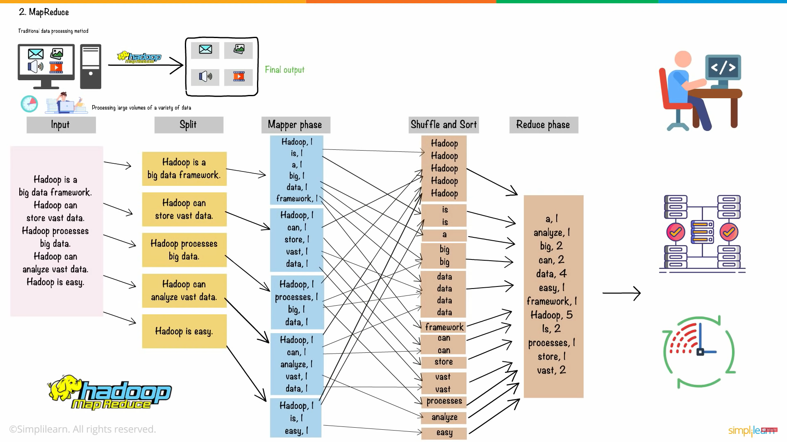
Notes:
Map Reduce Advantage → Load Balancing ,Scalability ,Fast and Cost Effective

Slide 7
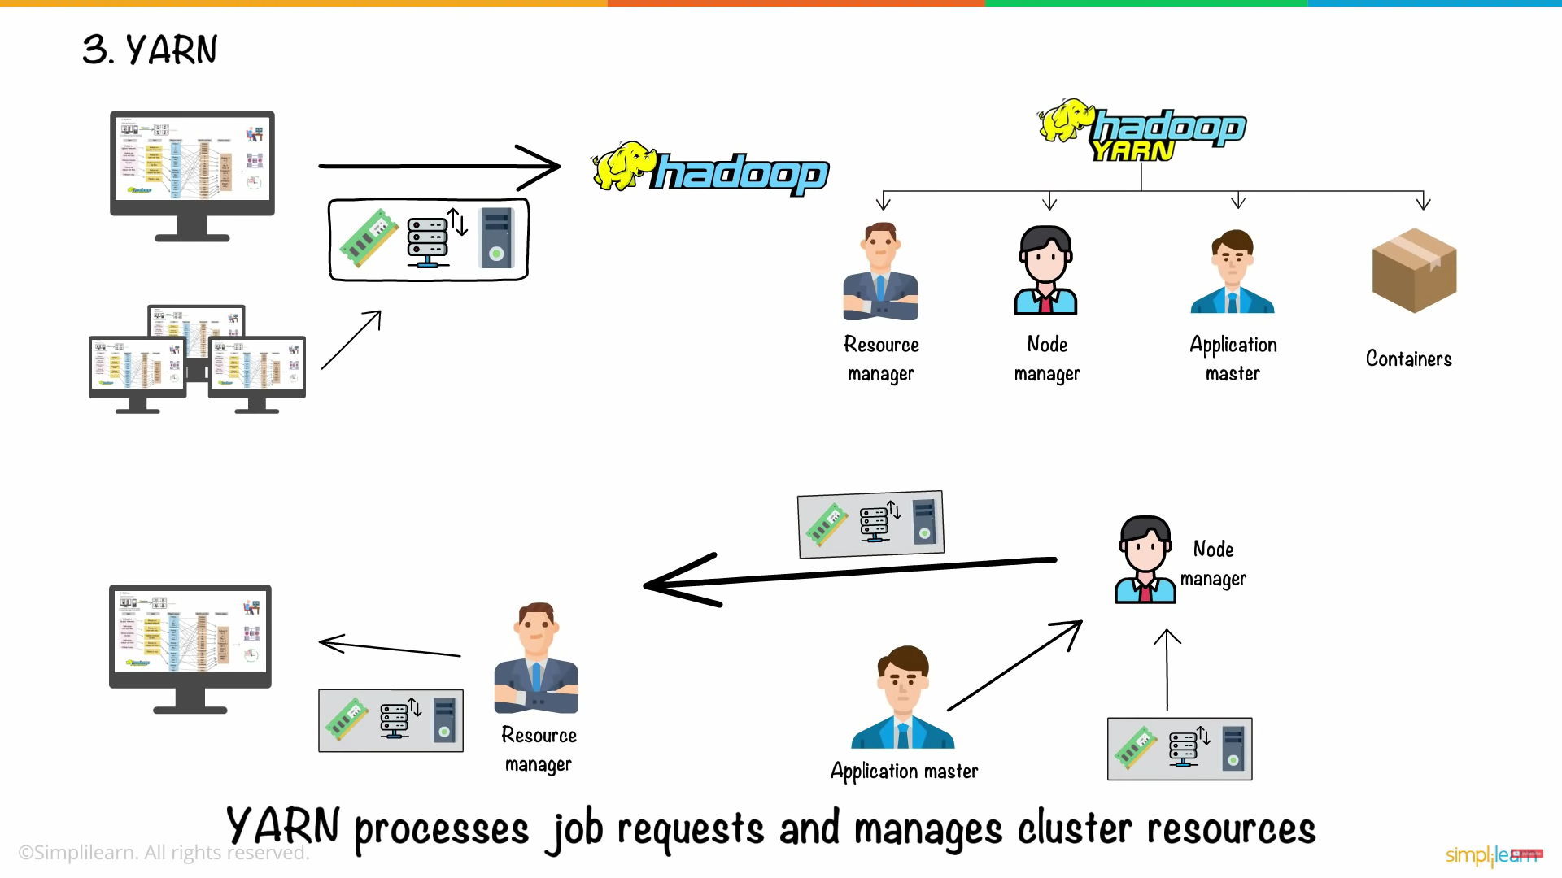
Notes:
Resource Manger → Assign the resources .
Node Manager → Manage the Nodes . Monitor resource usage in Nodes
Application Master → Manages the user job lifecycle and resource needs of individual applications
Containers → It is a collection of physical resources such as RAM, CPU cores and disk on a single node.

Slide 8
HIVE

Slide 9
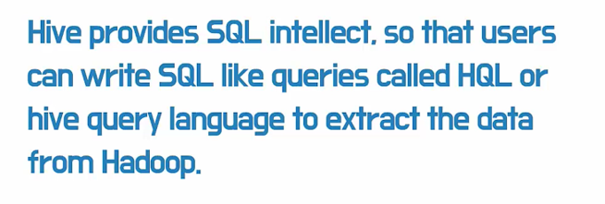
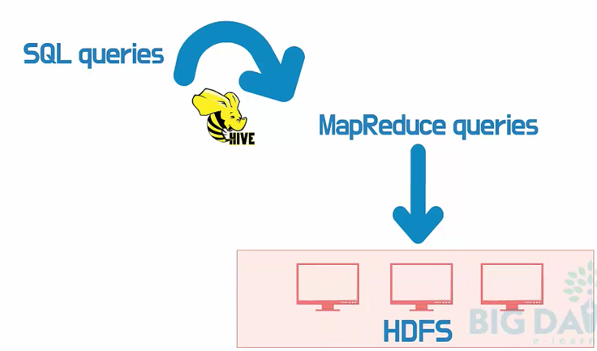
Hive is a Open Source data warehouse system which is used to analyze structured data. It is built on the top of Hadoop. It was developed by Facebook.

Slide 10
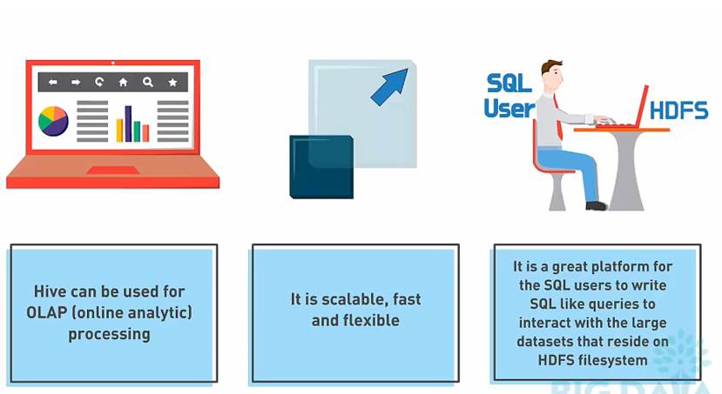
Hive Can Be Used :

Slide 11
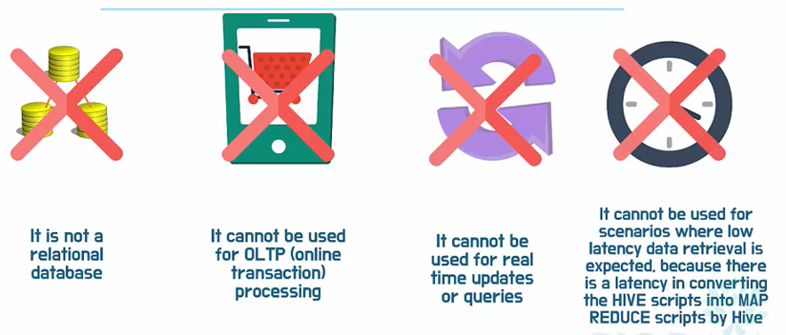
Hive Cannot Be Used:

Slide 12
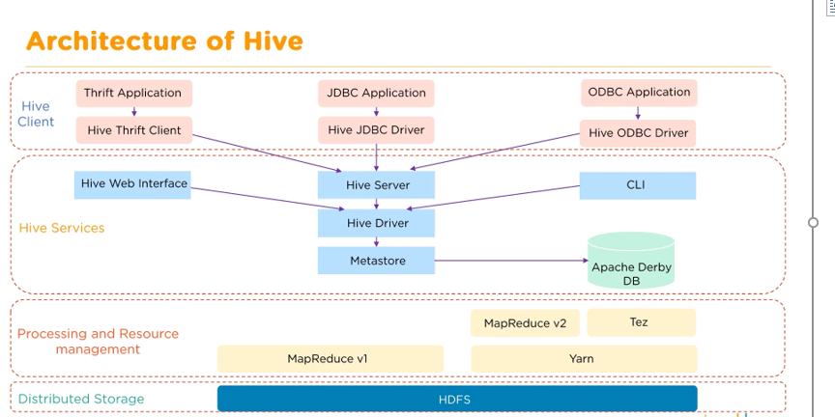

Slide 13
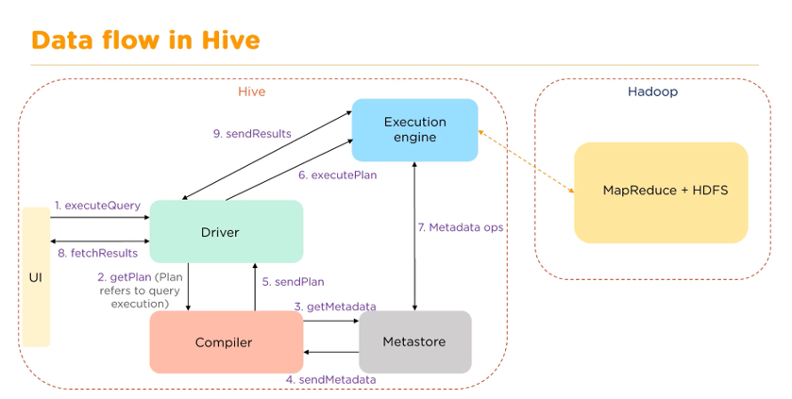

Slide 14
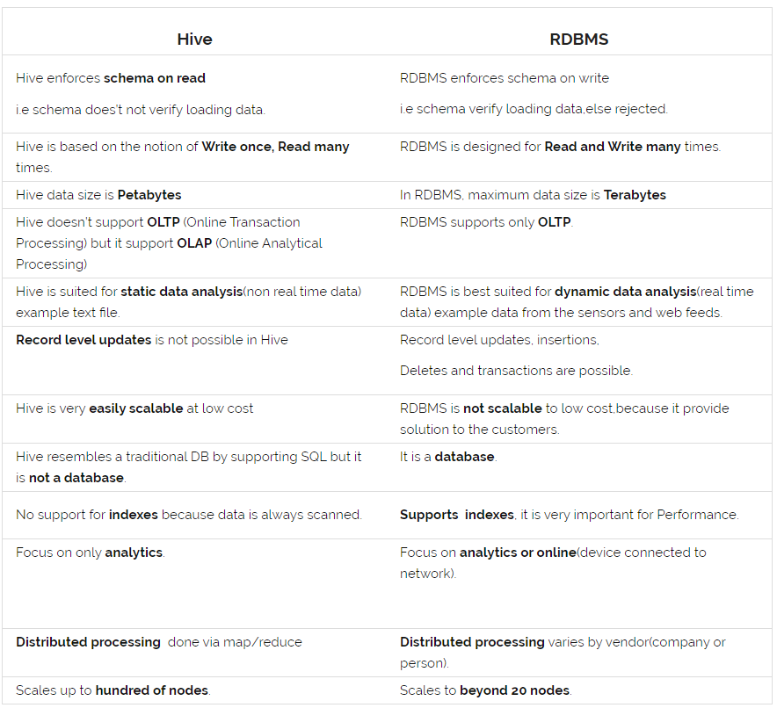

Slide 15
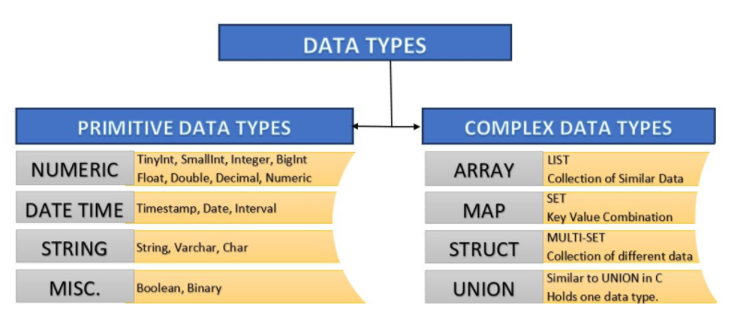
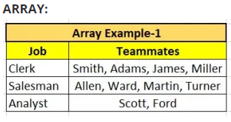
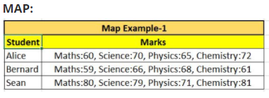
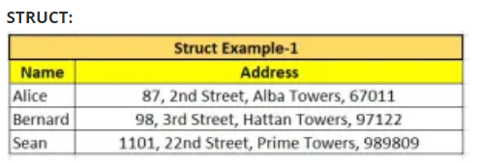

Slide 16
File Formats

Slide 17
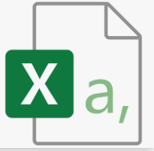
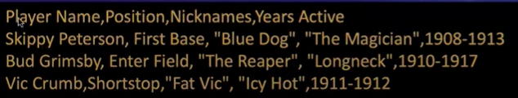

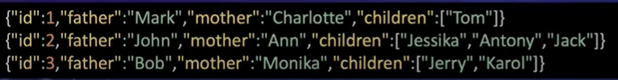

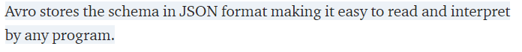

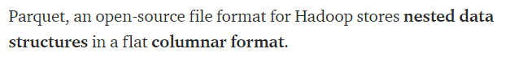
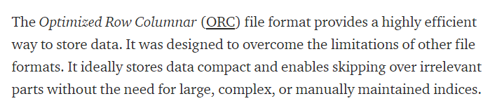


Slide 18
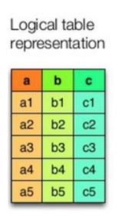
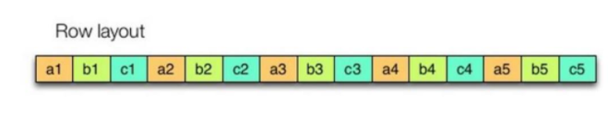
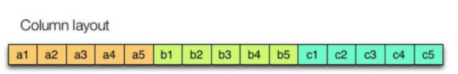
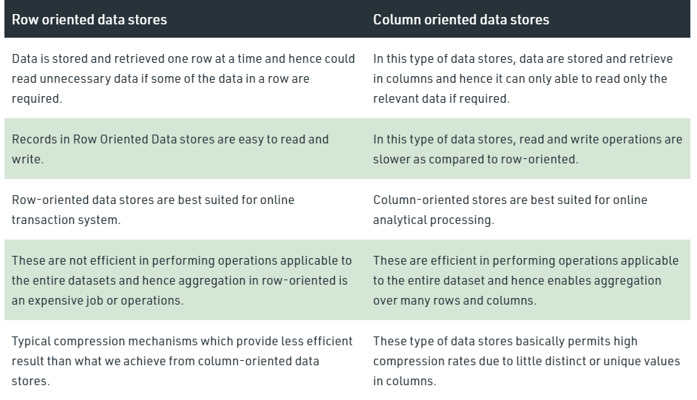

Slide 19
SQL Queries

Slide 20
Create Database Query : “create database demo;”
Create Table Syntax:
CREATE TABLE IF NOT EXISTS employee ( eid int, name String,
salary String, destination String)
COMMENT ‘Employee details’
ROW FORMAT DELIMITED
FIELDS TERMINATED BY ‘\t’
LINES TERMINATED BY ‘\n’
STORED AS TEXTFILE
;

Slide 21
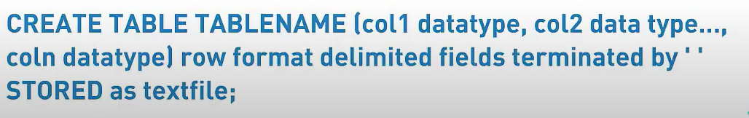
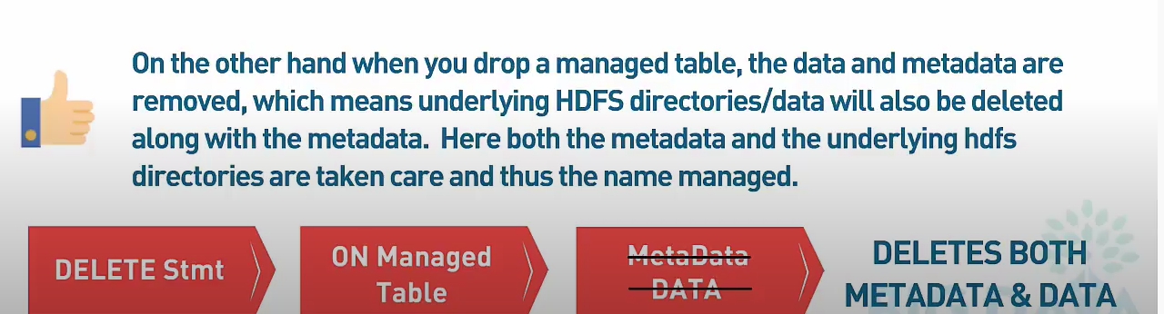
Managed Table:

Slide 22
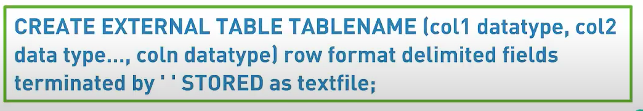

External Table:

Slide 23
Partitioning
The partitioning in Hive means dividing the table into some parts based on the values of a particular column like date, course, city or country.
The advantage of partitioning is that since the data is stored in slices, the query response time becomes faster.
Two Types Partitions In Hive:
Static partitioning
Dynamic partitioning

Slide 24
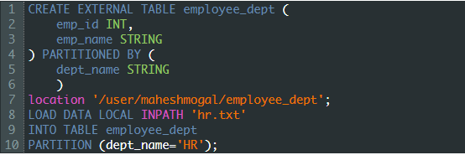
Static partitioning
In static or manual partitioning, it is required to pass the values of partitioned columns manually while loading the data into the table
2. Dynamic partitioning
In dynamic partitioning, the values of partitioned columns exist within the table. So, it is not required to pass the values of partitioned columns manually

Slide 25
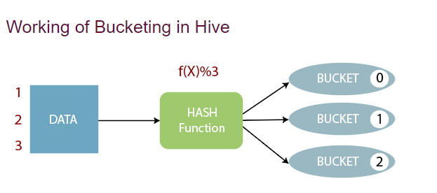

Bucketing
The bucketing in Hive is a data organizing technique.
It is similar to partitioning in Hive with an added functionality that it divides large datasets into more manageable parts known as buckets

Slide 26
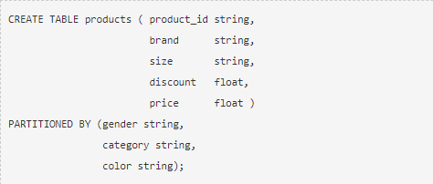
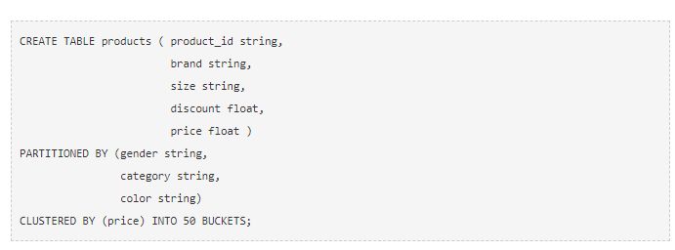
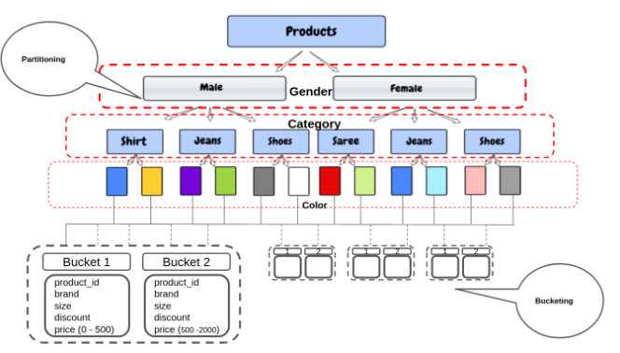
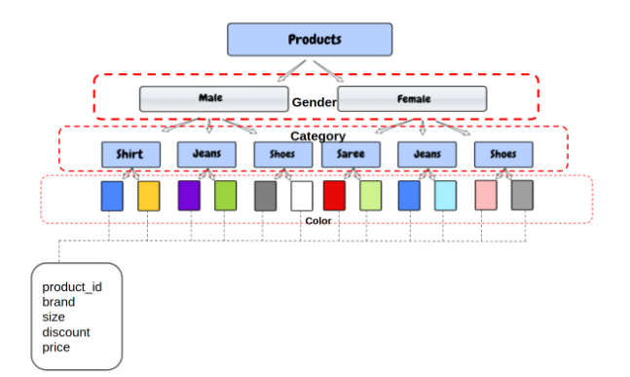
Partitioning
Partitioning with Bucketing

Slide 27


Slide 28
Useful Links:
https://www.youtube.com/watch?v=bAyrObl7TYE
https://blog.clairvoyantsoft.com/big-data-file-formats-3fb659903271
https://www.youtube.com/watch?v=DCaiZq3aBSc
https://www.youtube.com/watch?v=biH_l14KGqU
https://www.youtube.com/watch?v=Kr_AAkzGZsI

